Slide 1

AIRPORT AUTHORITY DATA ANALYSIS
P.DEEPIKA

Slide 2
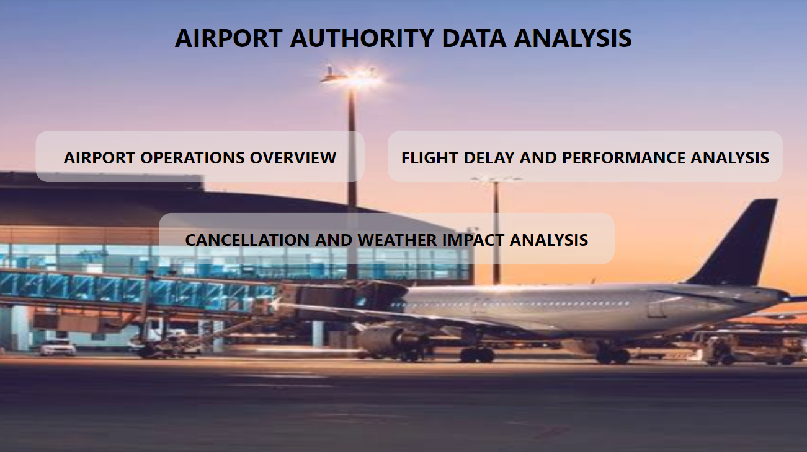

Slide 3
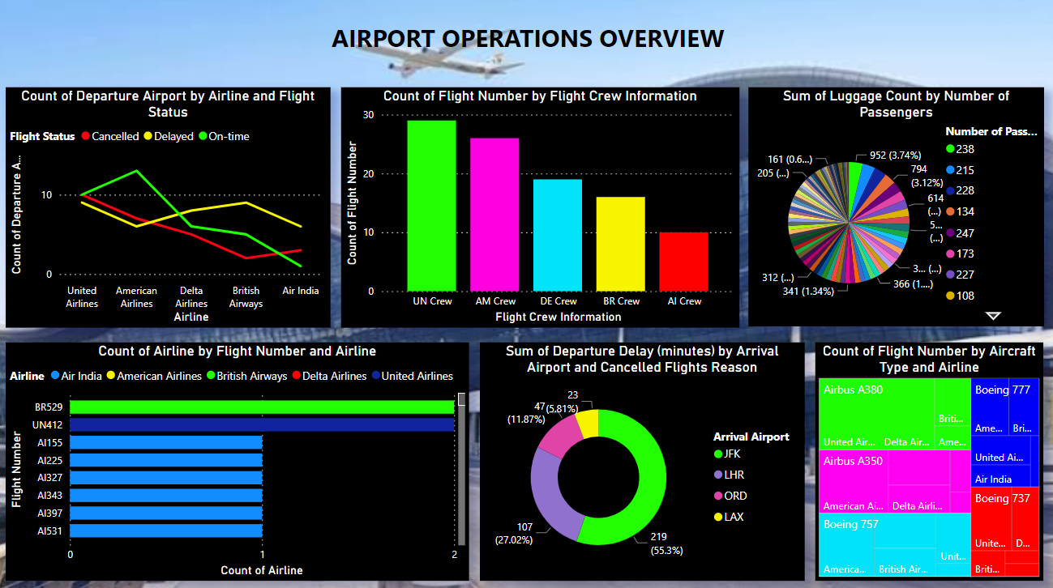

Slide 4
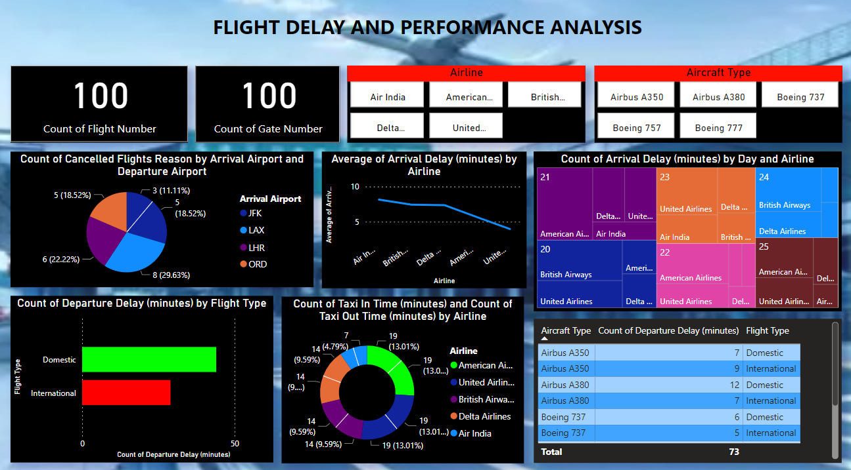

Slide 5
